Slide 1

Pneumonia Detection
Using
Deep Learning
Krishnakumar R
CB.SC.P2CSE23025

Slide 2

Introduction
In this presentation, we will explore the advancements in pneumonia detection through the use of Convolutional Neural Networks (CNNs). We will discuss the potential impact of this technology on healthcare and the challenges that lie ahead.

Slide 3
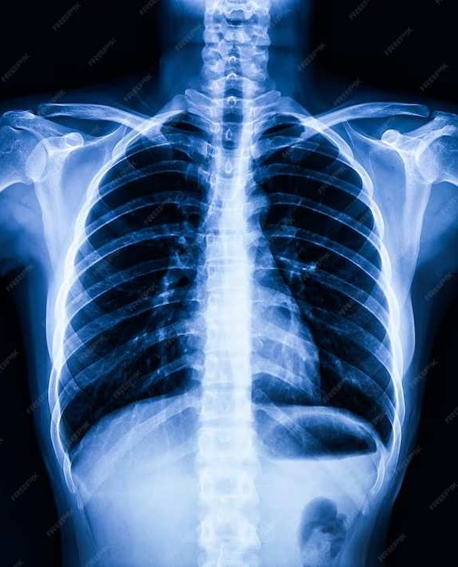
Understanding
Pneumonia is a common respiratory infection that can be life-threatening, especially for vulnerable populations. Early and accurate detection is crucial for effective treatment and improved patient outcomes.

Slide 4
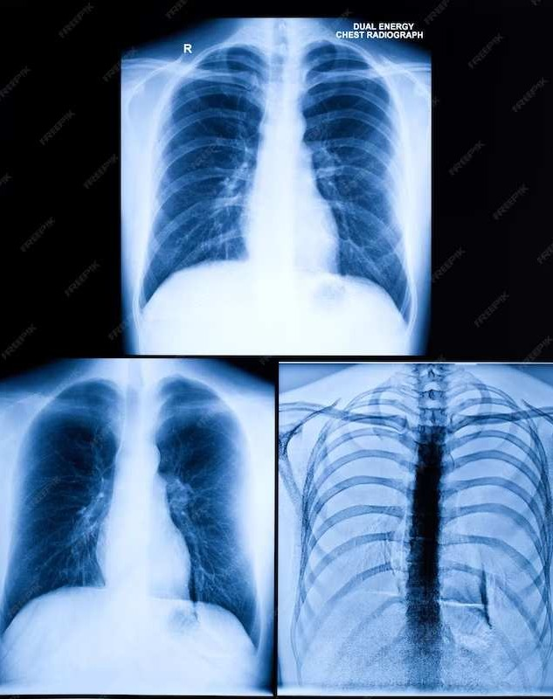
Challenges in Detection
Traditional pneumonia detection methods rely on manual interpretation of medical imaging, leading to subjectivity and human error. This can result in delayed diagnosis and treatment.

Slide 5

Role of CNNs
Convolutional Neural Networks offer the potential to automate pneumonia detection from medical imaging with high accuracy. By leveraging deep learning, CNNs can analyze large datasets and identify subtle patterns indicative of pneumonia.

Slide 6
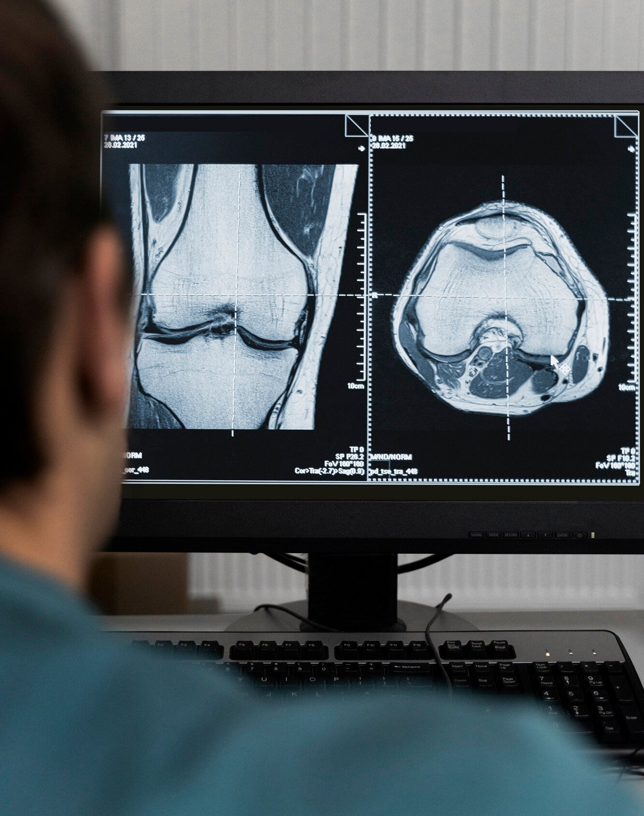
Training Data
Access to diverse and annotated datasets is crucial for training CNNs to accurately detect pneumonia. The quality and quantity of training data directly impact the performance and reliability of the model.

Slide 7
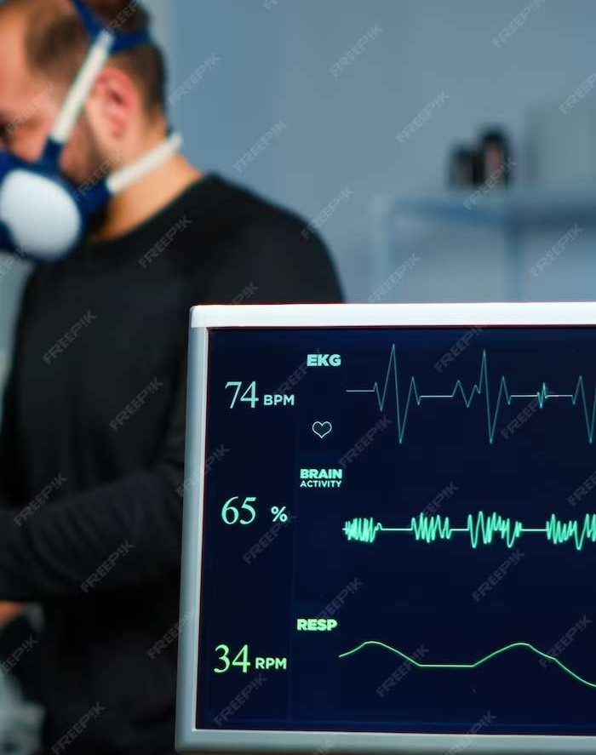
Performance Evaluation
Validating the performance of CNNs for pneumonia detection requires rigorous evaluation metrics such as sensitivity, speciﬁcity, and area under the curve (AUC). These metrics assess the model's ability to accurately identify pneumonia cases.

Slide 8
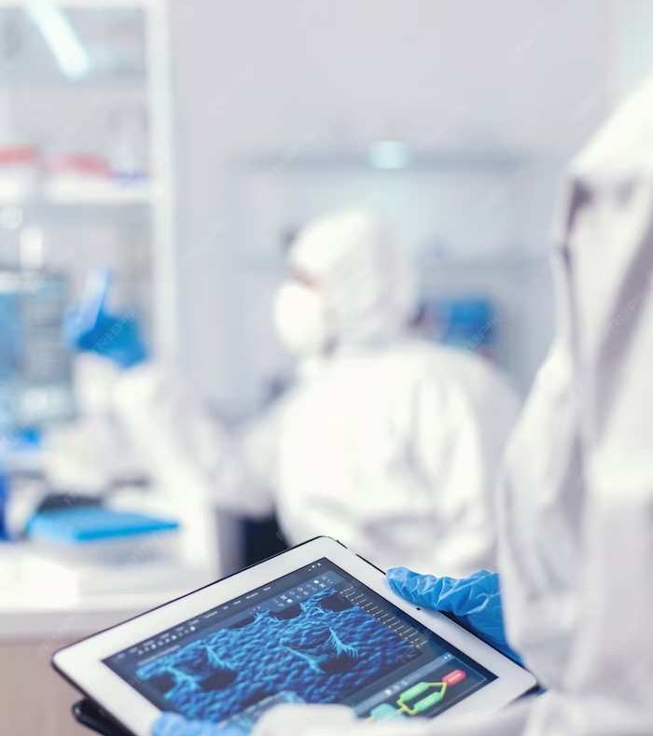
Clinical Implementation
detection into clinical practice requires collaboration between healthcare professionals and data scientists. Addressing regulatory requirements and ensuring ethical considerations are essential for safe and effective
deployment.

Slide 9

Future Prospects
The future of pneumonia detection lies in enhancing CNN models with multi- modal data and real-time analysis.
Additionally, advancements in explainable AI can provide insights into the decision-making process of CNNs.

Slide 10

Challenges Ahead
Despite the potential, challenges such as interpretability, bias mitigation, and data privacy must be addressed to ensure the responsible and equitable use of CNNs in pneumonia detection.

Slide 11
Conclusion
In conclusion, leveraging Convolutional Neural Networks for pneumonia detection holds promise for improving diagnostic accuracy and patient outcomes. With continued research and collaboration, CNNs can revolutionize the ﬁeld of respiratory healthcare.

